Slide 1
Performance & Resource Utilization Analysis
Demo Agency Tables - System Metrics Overview

Slide 2
Resource Utilization Analysis for Demo Agency Tables
Key Metrics:
1. Total Demo Agency Tables: 345
2. CPU Utilization:
Maximum: 33.7%
Minimum: 3.7%
3. Peak Memory Utilization:
Maximum: 59.11 Gb
4. Executors:
Maximum Executors Used: 1
Total Usable Memory per Executor: 125.79 Gb
5. Cluster Configuration:
Active Nodes: 2

Slide 3
Resource Utilization Analysis for Demo Agency Tables
Worker Node Configuration:
Memory per Worker: 128 Gb
Total Worker Memory (for 5 Workers): 640 Gb
Cores per Worker: 16
Total Worker Cores (for 5 Workers): 80
2. Execution Memory Allocation:
Execution Memory per Worker (30% of Total Memory): 38.4 Gb
Total Execution Memory Available Across Workers: 192 Gb
3. Demo Agency Execution Memory & Parallel Execution Assumption:
Demo Agency Execution Memory Utilized: 28.97 Gb
Estimated Parallel Execution Capability: 6.627

Slide 4
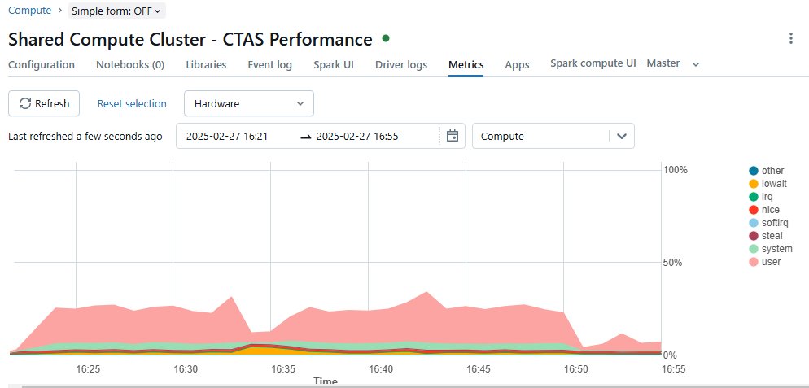
CPU utilization driver consumption

Slide 5
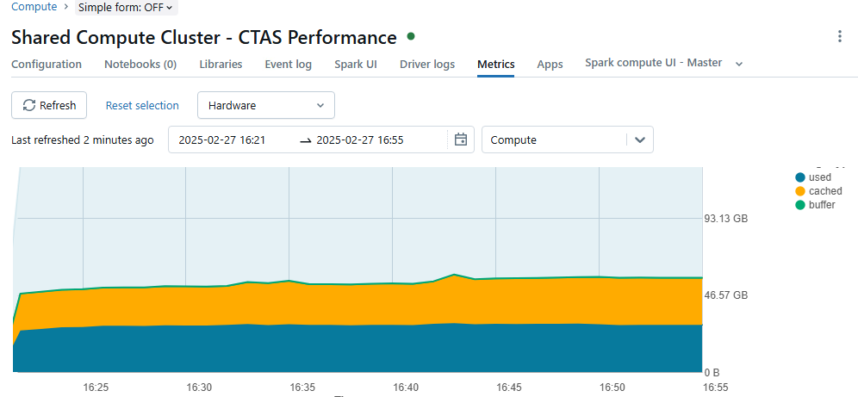
Memory utilization

Slide 6
Number of active node

Slide 7
Cluster Types
Feature | All purpose cluster | Job cluster
Scalability | Manual scaling possible (All-purpose clusters can be manually scaled up or down based on the workload. Users have the flexibility to adjust the number of worker nodes as needed) | Not scalable (Job clusters are not scalable once they are created. They are configured with a fixed number of worker nodes based on the job requirements and cannot be resized during execution.)
Cost | May incur idle charges (All-purpose clusters can incur idle charges if they are left running without active workloads. This can lead to higher costs if not managed properly.) | Lower cost due to on-demand nature (Job clusters are more cost-effective because they are only active during job execution. They are automatically terminated after the job is completed, minimizing idle time and reducing costs.)
Use Case | Interactive analysis, collaboration | Scheduled jobs, batch processing
Number of Users | Multiple users | Single job

